Slide 1
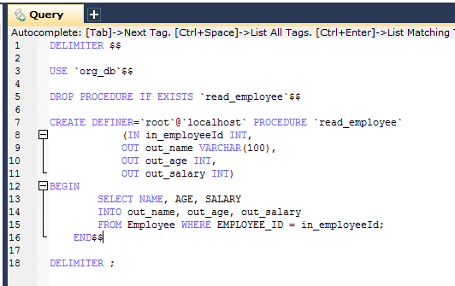
Explicitly declaring parameters to use for a SimpleJdbcCall
The in_employeeId parameter contains the id of the employee you are looking up.
The out parameters return the data read from the table.

Slide 2
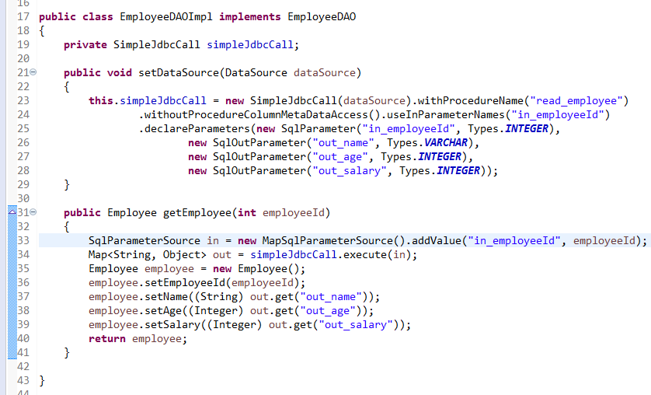
Explicitly declaring parameters to use for a SimpleJdbcCall
We have seen how the parameters are deduced based on metadata, but we can declare then explicitly if you wish. We do this by creating and configuring SimpleJdbcCall with the declareParameters method, which takes a variable number of SqlParameter objects as input.
Explicit declarations are necessary if the database you use is not a Spring-supported database. Currently Spring supports metadata lookup of stored procedure calls for the following databases: Apache Derby, DB2, MySQL, Microsoft SQL Server, Oracle, and Sybase. Spring also support metadata lookup of stored functions for: MySQL, Microsoft SQL Server, and Oracle.
You can opt to declare one, some, or all the parameters explicitly. The parameter metadata is still used where you do not declare parameters explicitly. To bypass all processing of metadata lookups for potential parameters and only use the declared parameters, you call the method withoutProcedureColumnMetaDataAccess as part of the declaration. Suppose that you have two or more different call signatures declared for a database function. In this case you call the useInParameterNames to specify the list of IN parameter names to include for a given signature.

